Slide 1
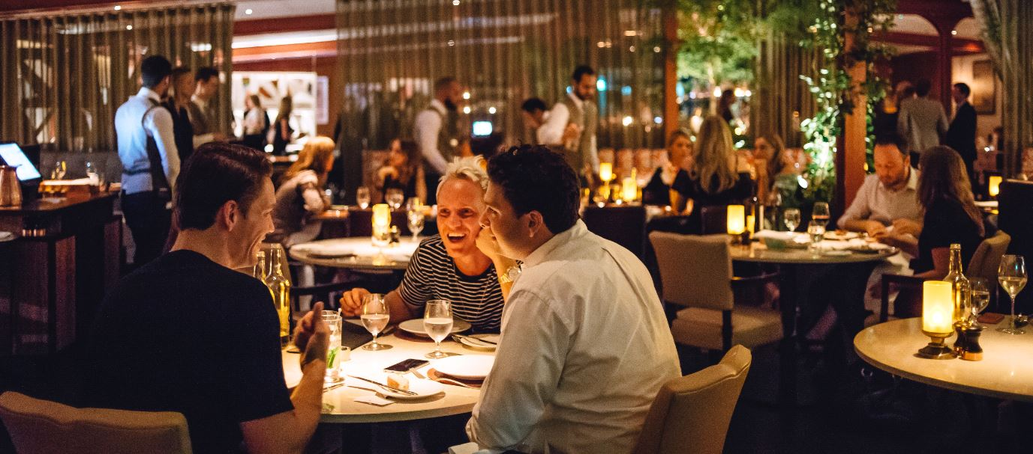

Restaurant App
Presented By:
JAYAPRASAD M
AKSHATHA
ANIL RAMESH
RISHAV KR CHOURASIA
SACHIN MURAL
ABHINAB DUTTA GUPTA

Slide 2
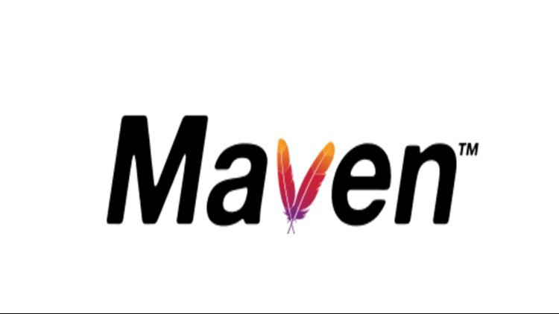
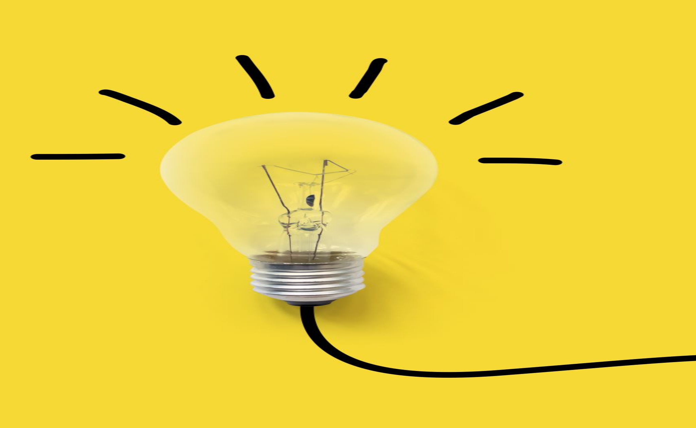
CONTENTS
Business Requirements
Class Diagram
Tech Stack
Screenshots
Demo

Slide 3
Business Requirements
You need to build "Restaurant App" project which should have bare minimum CRUD capabilities.
For example: Let take an example of Facebook app:
Create post
Edit added post
List different posts
Delete post

Slide 4
SERVER PREREQUISITE
HARDWARE REQUIREMENTS:
4GB RAM
4GB CPU
SOFTWARE REQUIREMENTS:
Ansible
Docker
Jenkins
Kubernetes
Kafka
Nexus as a docker container

Slide 5
WORKFLOW DIAGRAM
User
Home
Home
Orders
Cart
Payment
Admin
Home
Orders
Products
Customers

Slide 6
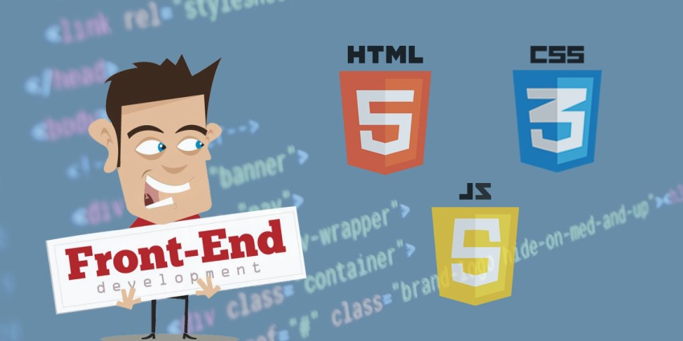
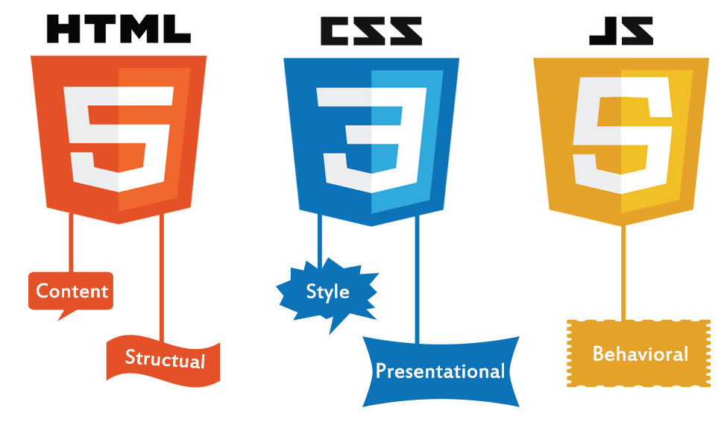

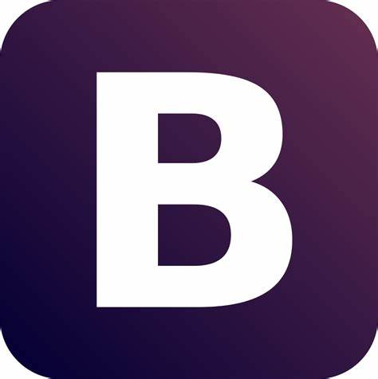
TECH STACK

Slide 7
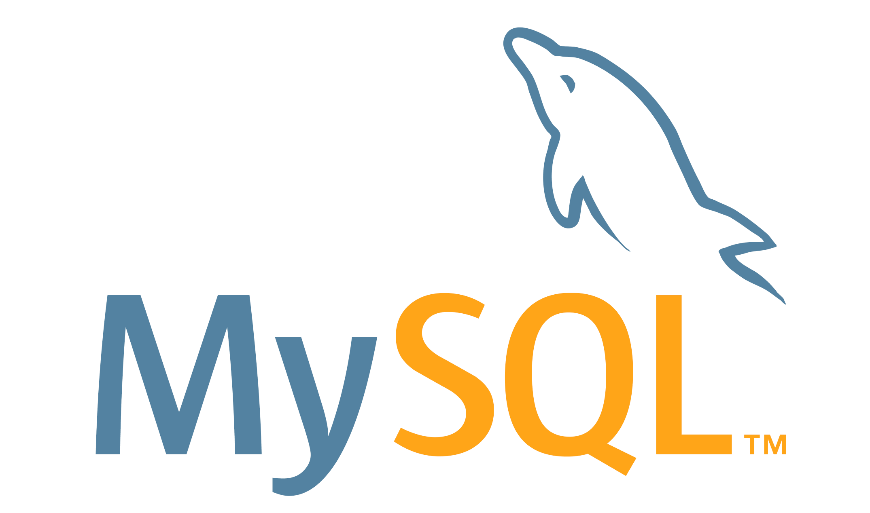
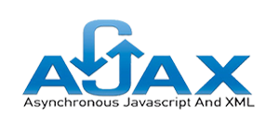

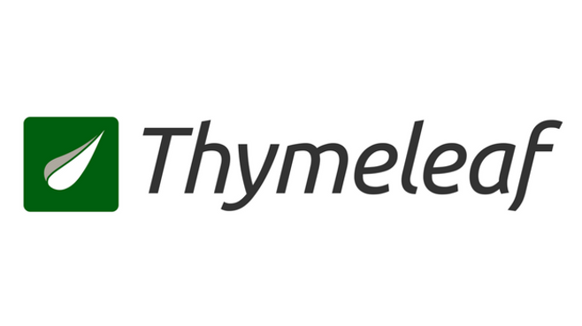
Backend Part
JSONArray
[{"Name":"Ram","Age":"23","Gender":"M"},
{"Name":"Alex","Age":"12","Gender":"M"},
{"Name":"Karan","Age":"76","Gender":"M"}]

Slide 8
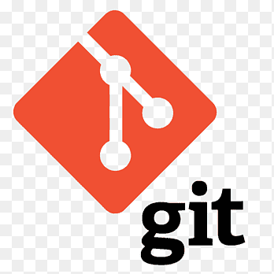
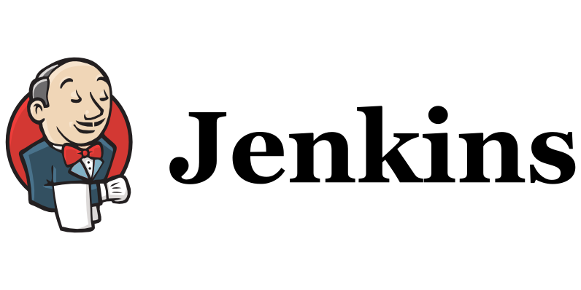
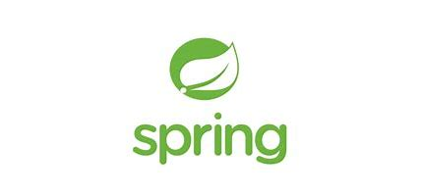
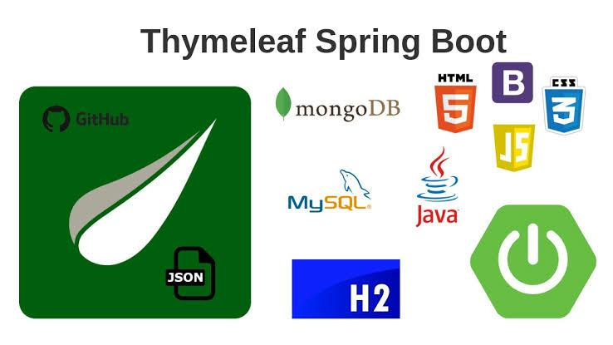
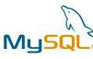
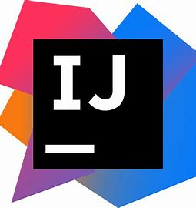
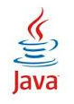
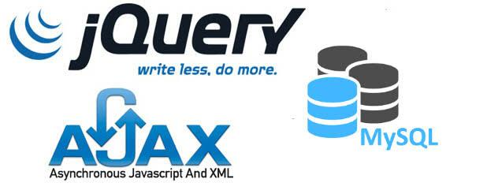
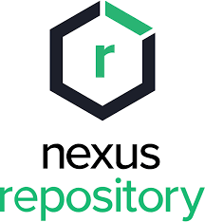
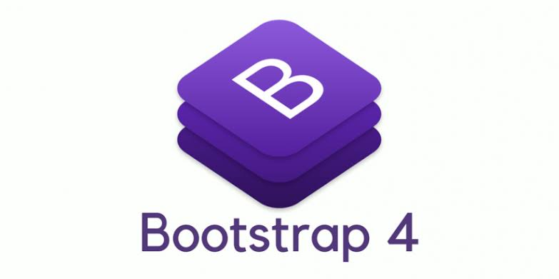
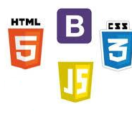
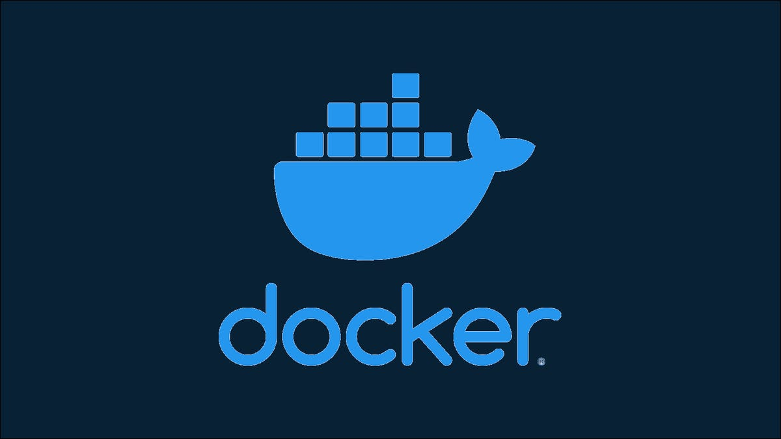
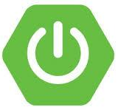
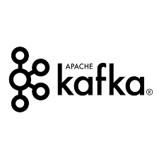
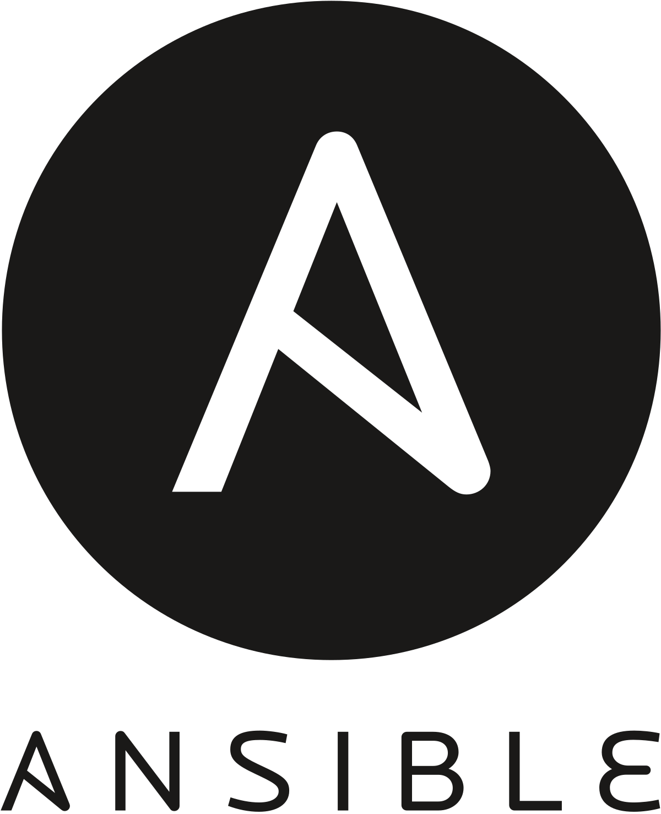
TECH STACK

Slide 9
DEVOPS TOOLS
ANSIBLE: Ansible Playbook(yaml file) is used to install required software to run our application in system.
We have written a playbook.yaml that is stored in git repository to install the pre-requisites software for server environment.
DOCKER: Docker is used to create an image of our application and push the image into Docker hub.
We have written a Dockerfile that is stored in git repository.

Slide 10
KUBERNETES(K8S): Kubernetes is used to create pods, deployments and services for our application.
We have written db-deployment.yml and app-deployment.yml files to deploy Mysql pod and application pod respectively.
GIT: Git is used to store our application code in repository for easy retrieval.
NEXUS: Nexus is used to create Artifact for our application.

Slide 11
KAFKA: Kafka is used to store user activities like adding products to cart, download the bill etc. in Kafka topic.
JENKINS: In Jenkins file we have following stages:
Building Maven artifact of application
Pushing Artifact to Nexus
Creating Docker image of application
Pushing the image to docker hub
Creating kubernetes Mysql pod deployment
Creating kubernetes application pod

Slide 12

JENKINS PIPELINE
GIT PULL
MAVEN BUILD/
ARTIFACT
PUSHING
ARTIFACT TO NEXUS REPOSITORY
BUILD DOCKER IMAGE
KUBERNETES
SPRING BOOT APP DEPLOYMENT
KUBERNETES
MYSQL DEPLOYMENT
PUSH TO DOCKER HUB

Slide 13
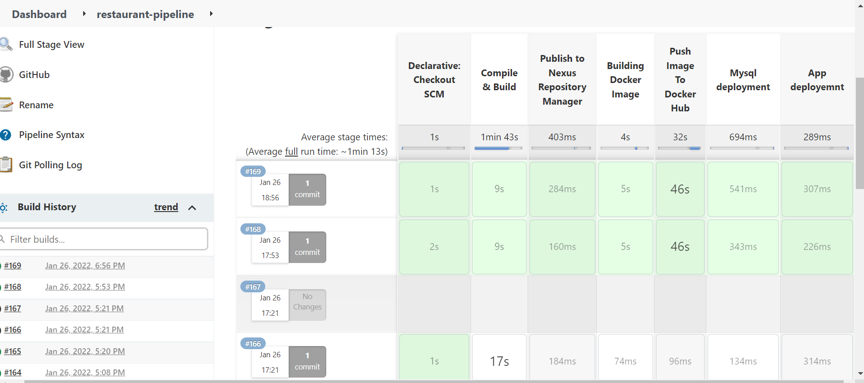
JENKINS PIPELINES

Slide 14
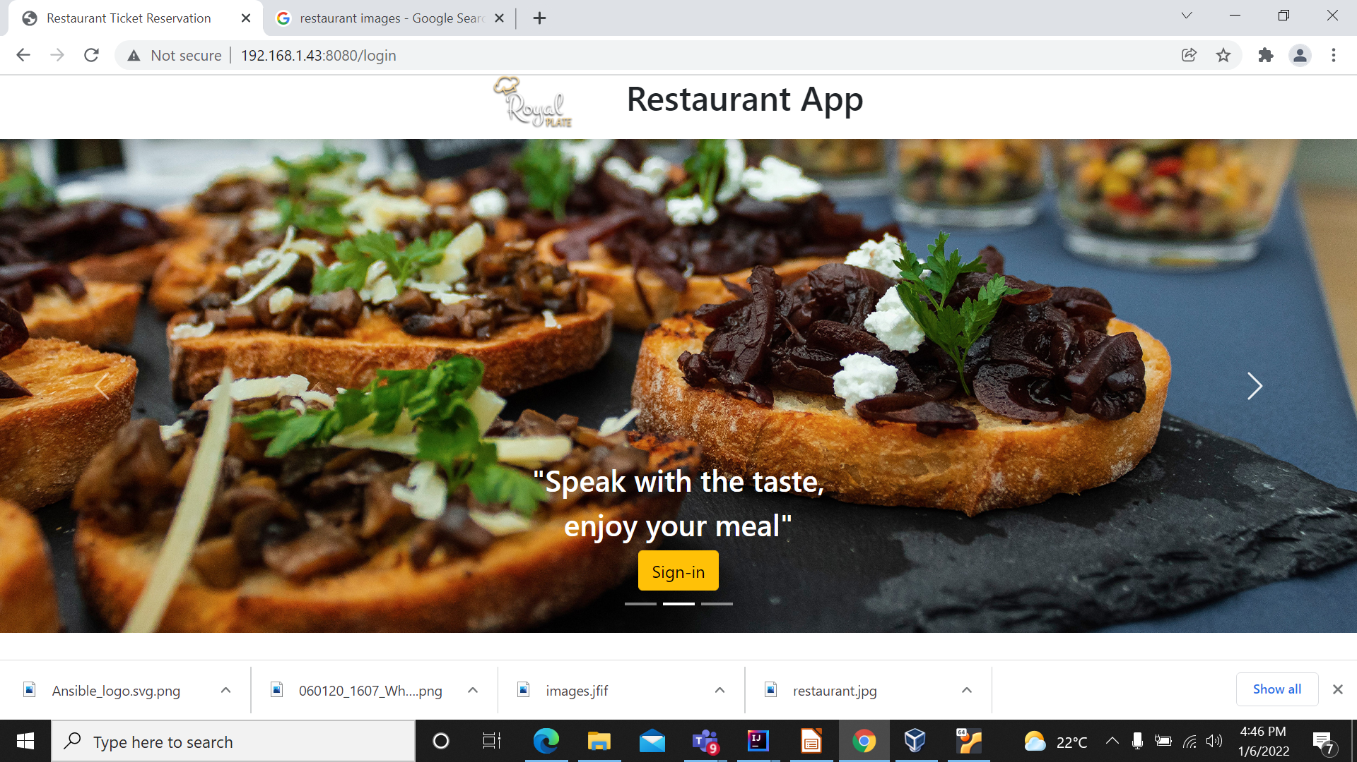
Screen Shots of Applications -Home Page

Slide 15
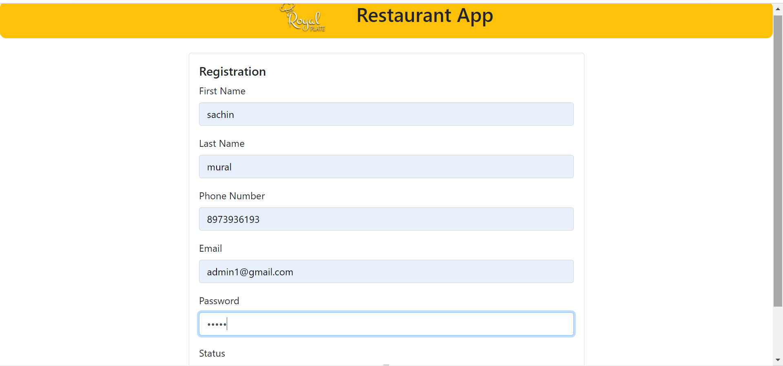
Registration Page

Slide 16
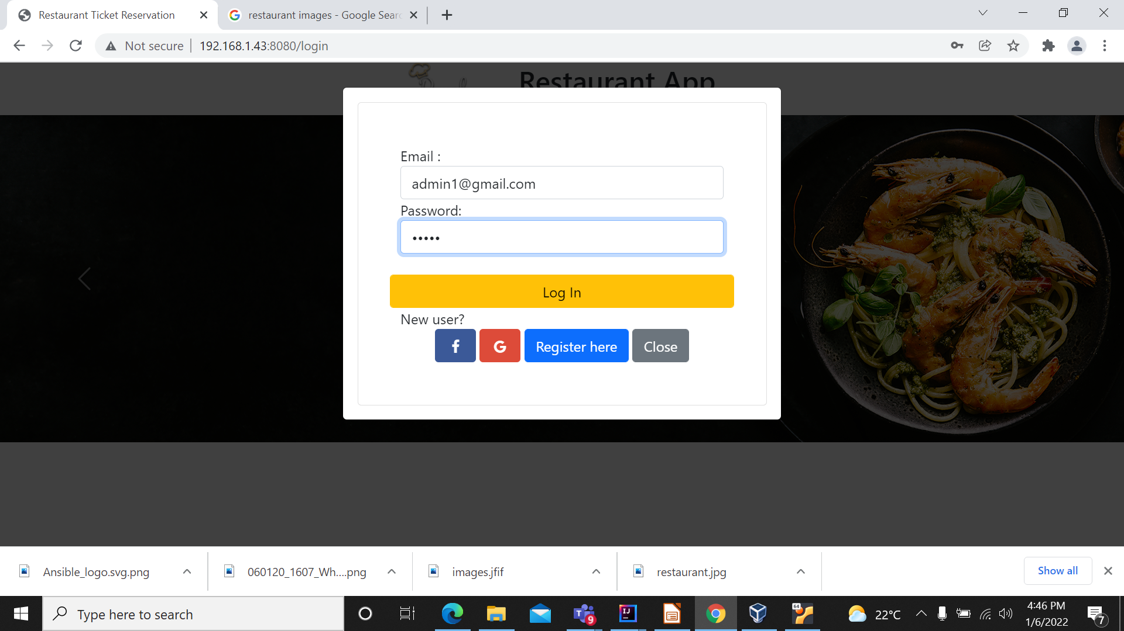
Login Details

Slide 17
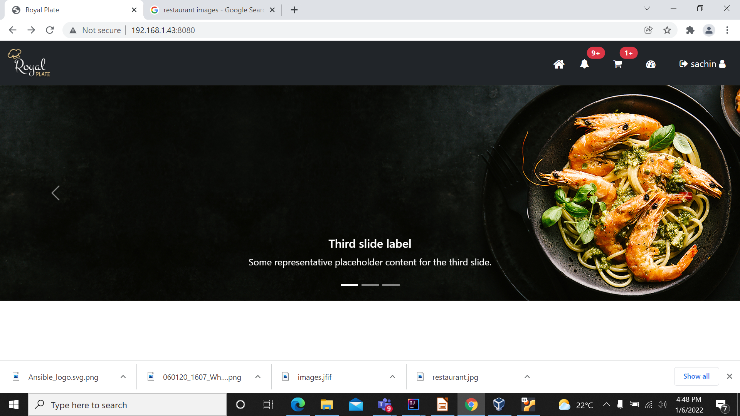
Admin home page

Slide 18
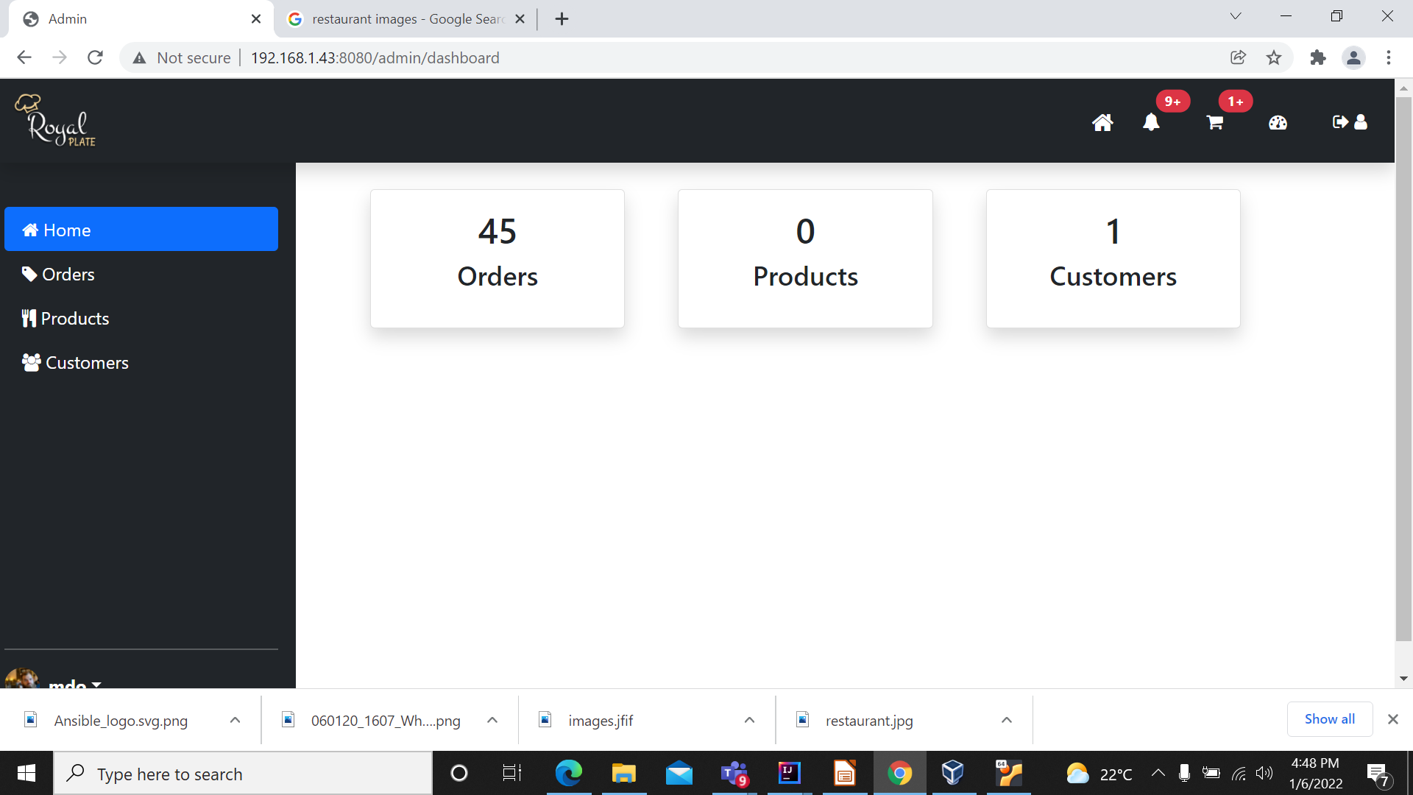
Dashboard Details

Slide 19
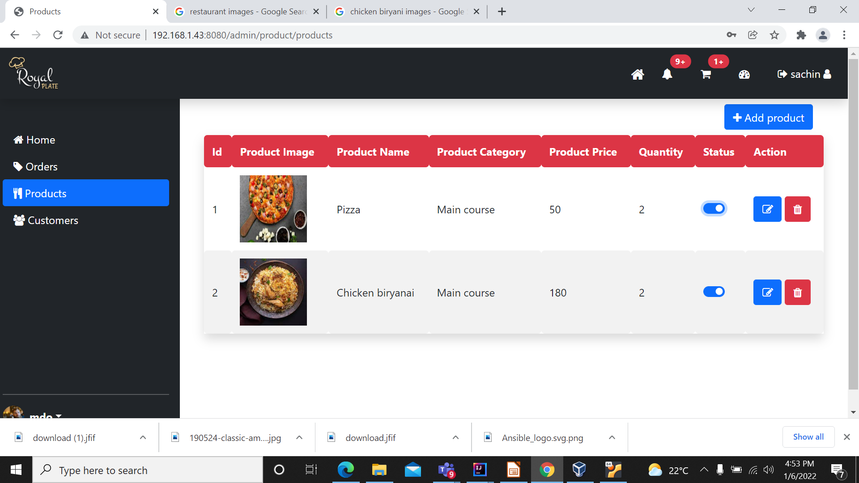
Add Products

Slide 20
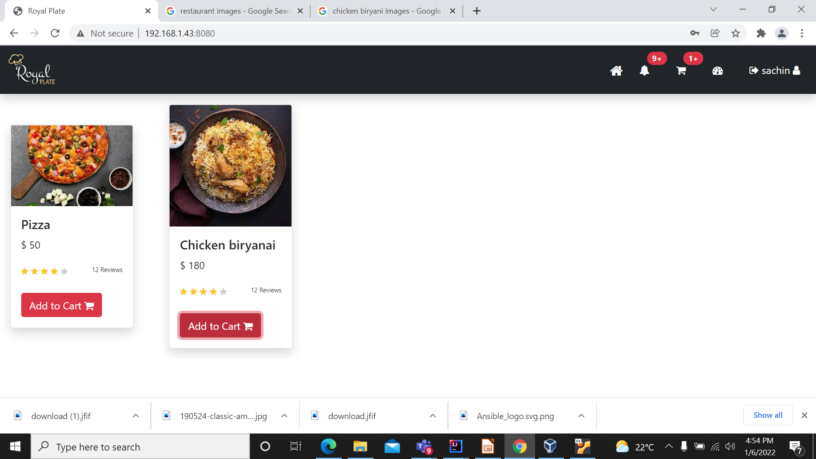
Add to cart

Slide 21
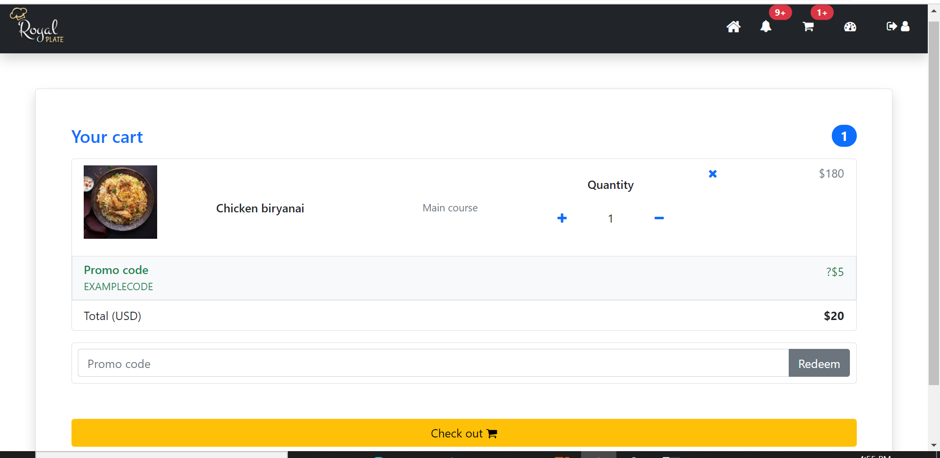
Payment page

Slide 22


Let's move on to Project Demo

